Slide 1
Red Brand Canner Case
By Jack & Yang

Slide 2
Problem Statement
Red Brand Canner - A company packages fruit & vegetables in cans and make profit
Determine how many whole tomato cans, tomato juice, and tomato paste the company should produce
20% grade ‘A’ tomato, 80% grade ‘B’ tomato, 3 million pounds
Mix the two kinds of tomato to make sure the products can meet certain standards
Determine whether or not to purchase an extra 800,000 pounds of grade ‘A’ tomato

Slide 3
Problem Statement Cont’d
Assumptions:
Only whole tomato, tomato juice and tomato paste are being produced
Use unit net profits given in Exhibit 2 and ignore Exhibit 3
Ignore the difference in individual quality of each type of tomato and assume all tomato can achieve average level for quality constraints of mixtures

Slide 4
Define Variables
Wa - Amount of grade ‘A’ tomato used to produce whole tomato
Wb - Amount of grade ‘B’ tomato used to produce whole tomato
Ja - Amount of grade ‘A’ tomato used to produce tomato juice
Jb - Amount of grade ‘B’ tomato used to produce tomato juice
Pa - Amount of grade ‘A’ tomato used to produce tomato paste
Pb - Amount of grade ‘B’ tomato used to produce tomato paste
Xa - Amount of extra grade ‘A’ tomato purchased

Slide 5
Objective Function
Total amount of whole tomato = Wa + Wb
Total amount of tomato juice = Ja + Jb
Total amount of tomato paste = Pa + Pb
Extra tomato cost = Xa * 0.255
Max Z = (Wa+Wb)*0.36/18 + (Ja+Jb)*(-0.27)/20 + (Pa+Pb)*0.36/25 - 0.255*Xa

Slide 6
Quality Constraints
Whole Tomato: Wa * 9 + Wb * 5 >= (Wa + Wb) * 8
Tomato Juice: Ja * 9 + Jb * 5 >= (Ja + Jb) * 6
Tomato paste: Use entirely grade ‘B’ tomato

Slide 7
Demand Constraint
Whole Tomato: Wa + Wb <= 800,000 * 18
Tomato Juice: Ja + Jb <= 50,000 * 20
Tomato Paste: Pa + Pb <= 80,000 * 25

Slide 8
Quantity Constraint
Grade ‘A’ tomato: Wa + Ja + Pa <= 3,000,000 * 0.2 + Xa
Grade ‘B’ tomato: Wb + Jb + Pb <= 3,000,000 * 0.8
Extra tomato: Xa <= 800,000

Slide 9
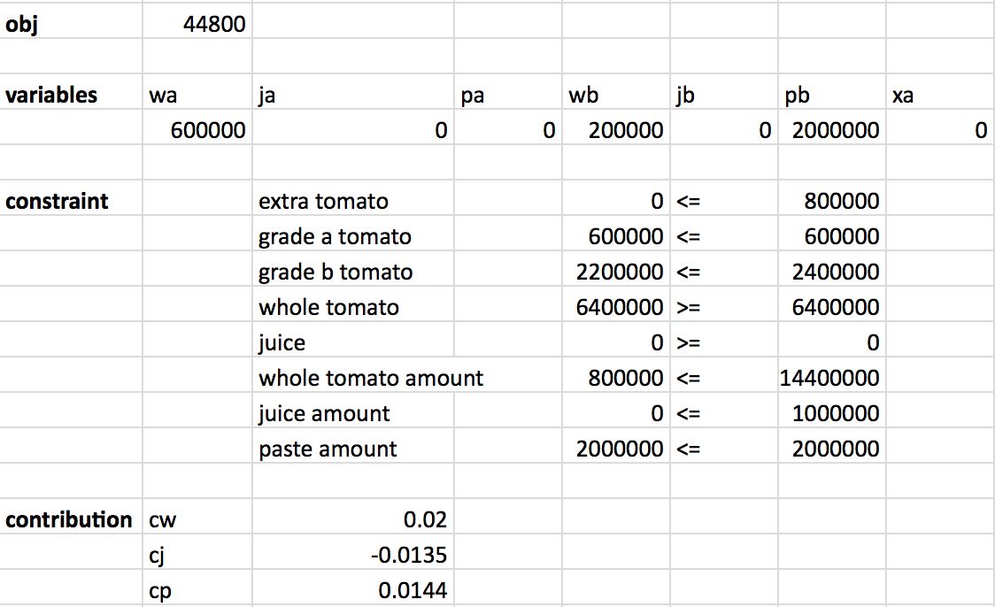
Excel Solver

Slide 10
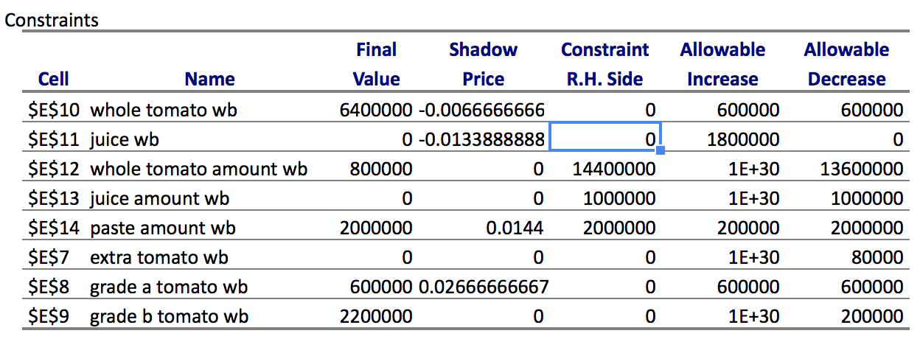
Sensitivity Analysis

Slide 11
Conclusion
The company should not purchase any of the extra grade ‘A’ tomatoes at $0.255 per pound
The total profit would increase when the demand of tomato paste increases, at a maximum amount of 200,000
The total profit would increase when extra grade ‘A’ tomatoes can be purchased under the price of 0.0266 per pound or lower
A maximum total net profit of 44,800 can be made, if 600,000 grade ‘A’ tomato and 200,000 grade ‘B’ tomato are used to produce whole tomato cans, and the rest of grade ‘B’ tomates are used to produce tomato paste.

Slide 12
Questions or Comments

